Slide 1


Where and how to implement security in software development

Slide 2



About us
Interests:
Application Security
Secure SDLC
Governance Risk & Compliance
Penetration Testing
Security Automation
Radostina Kodakova
Yordan Popov
Manager Cyber Security & Security Business at Scalefocus
Security Engineer at Scalefocus

Slide 3

Ignorance is the root cause of all difficulties
Plato

Slide 4
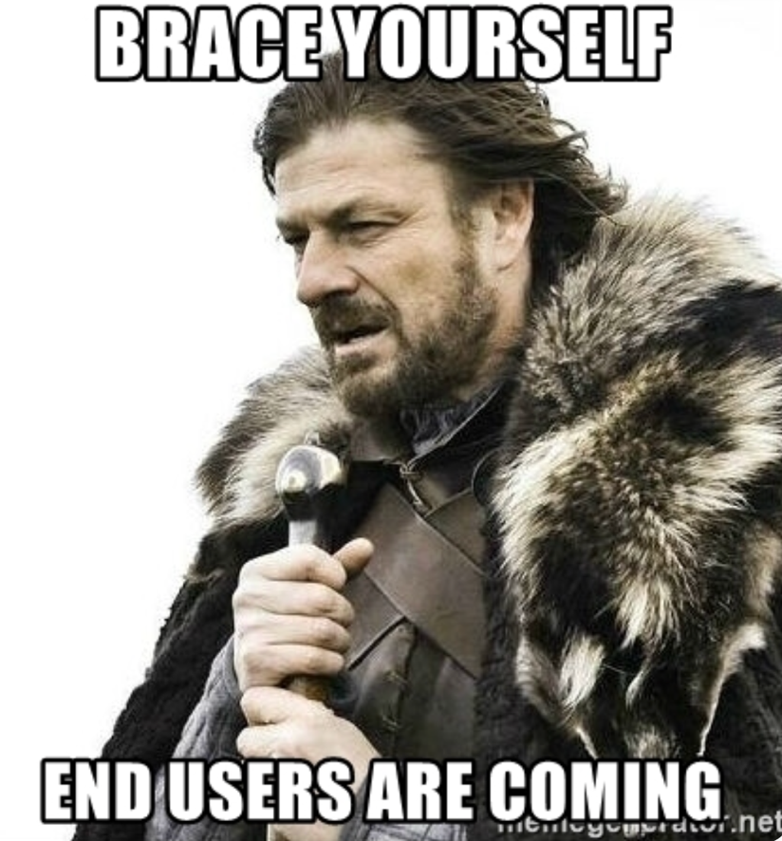
Adopt the Principles
Functionality
Principle 1: Security Is Everyone’s Responsibility
Principle 2: Prevention is the key to avoiding problems
Principle 3: There will never be 100% security guarantee
Security
Usability

Slide 5







Secure Software Development Life Cycle SSDLC
Software Development Life Cycle
6
1
Patch Management
Third-Party Library Upgrades
Policy & Document Maintenance
Continues Assessment & Monitoring
Security Requirements
Assurance Methodologies
Standards & Frameworks
Secure Software Development
Maintenance
Requirements & Planning
5
2
Security Testing
Review & Response Process
Security Bug Handling
Risk Analysis
Building Checklists
Security Baseline
Testing & Integration
Analysis
4
Implementation
Design
3
Security Coding Practices
SCA SAST & DAST
OSS License Compliance
Secure Code Reviews & Training
DevSec Ops
Security Hardening
Secrets Management
Secure Design Principles
Security Controls
Threat Monitoring
Policies and Procedures Enablement
Access Control Lists
Threat Monitoring
Security Hardening

Slide 6



Threat Modelling
Process by which potential threats, such as structural vulnerabilities or the absence of appropriate safeguards, can be identified, enumerated, and mitigations can be prioritized.
The father:
Adam Shostack

Slide 7


Reports-4-U
SOAP/
SSL
WS
Gateway
SOAP
Threat Modelling
A06
JSON/RES T-API
HTTPS
A03
C05
Legacy LAN
C06
A13
Legacy
System
HTTPS
WS-Legacy
TCP
Coyote Data
WS - API
SOAP/SSL
C04
FTP-D rop
SFTP
Web
Server
C06
A03
Session
Mgmt
Reporting
A06
Browser
TA02
TA01
A03
C06
A08
TA05
TA06
TA07
HTTPS
TCP
A01
Log
Mgmt
Business
Logic
A02
Flash
C02
C03
A04
A07
01
01
A03
Java Script
A13
Admin
Inter face
Flash
Interface
Define
A04
A11
Data
Warehouse
Diagram
Internet
DMZ
Application Server
ODBC
05
HHTPS
A12
TCP
C07
A04
ODBC
File
transfer
02
Browser
TA04
A03
C04
Mutual
SSL
C01
A10
C04
A09
C01
A02
Primary
DB Server
A02
Flash
A13
HHTPS
C01
A05
Reporting
DB Server
Validate
Java Script
Thick-Client
VisitWidget
ODBC
C09
A14
A03
SSL
ODBC
A04
Single
Sign-on
Server
Identify
Corporate LAN
TA03
C02
C03
A10
Data Center
04
03
Assets
A01: Primary DB credentials
A02: Sensitive application data
A03: Session tickets
A04: Application username and password
A05: Aapplication event tables
A06: Report data
A07: Coyote Data SFTP credentials
A08: Reports-4-U REST credentials
A09: VisiWidget API
A10: Active Directory username andpassword
A11: Special Flash functionality
A12: Client certificate for Thick-Client
A13: Application log file and event data
A14: Cached reporting data
Threat Agent
TA01: Unauthorized external user
TA02: Authorized external application user
TA03: Unauthorized internal user
TA04: Authorized internal application user
TA05: Authorized internal system admin
TA06: Authorized internal DB admin
TA07: Authorized developer
Controls
C01: Primary DB authentication and schema
C02: External application user authentication
C03: One-way SSL
C04: Mutual SSL
C05: IP address restrictions
C06: Token validation (for Reports-4-U)
C07: Salted SHA-256 hash of user passwords
C08: Internal user Flash SWF file
C09: 90-day limit for report data
Mitigate
Credits: Synopsys

Slide 8
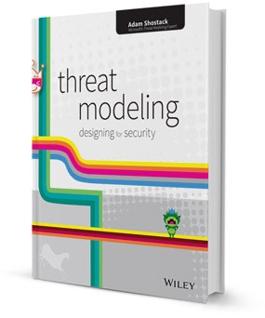

Threat Modelling
Video:
Threat Modelling in 2021 https://www.youtube.com/watch?v=7jB5OS6mepU
Implement Threat Modeling across the team it helps with:
Identifies & Prioritize Threats early
Reduces time to market
Applicable for all phases of SDLC
All team members are involved
Provides security knowledge & awareness
The Book:
https://www.amazon.com/Threat-Modeling-Designing-Adam-Shostack/dp/1118809998
The Game:
https://www.microsoft.com/en-us/download/details.aspx?id=20303
08

Slide 9
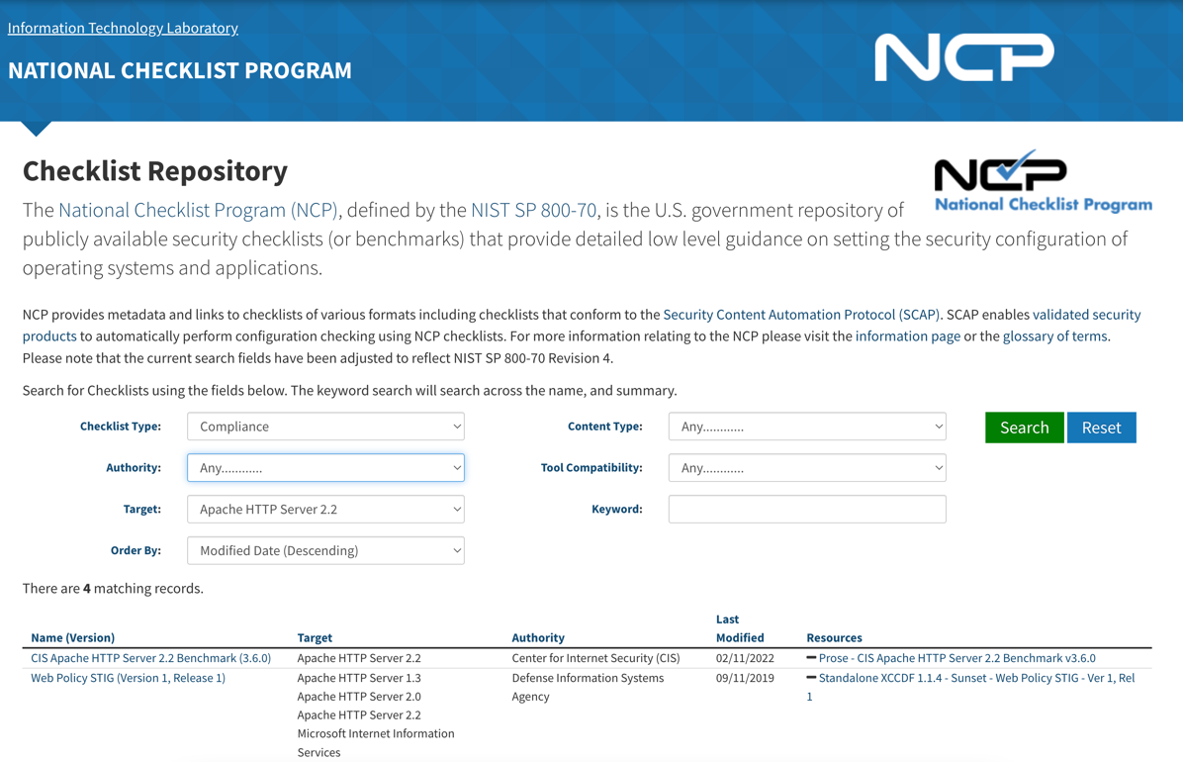
Security Hardening
How?
The practice of reducing a system's vulnerability by reducing its attack surface

Slide 10




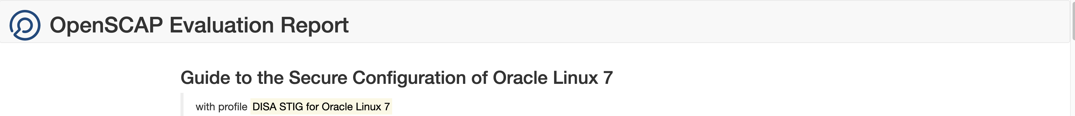
Security Hardening
Step 1: Download and install OpenSCAP
Step 2: Download the checklist from NVD or the OVAL Repository
Step 3: Run OpenSCAP with the checklist on the OS/software
Outcome: Vulnerability Report Secure Configuration Guide

Slide 11

Demo
SSDLC
Link
By Yordan

Slide 12

Q&A

Slide 13
Thank you!
Radostina LinkedIn
Yordan LinkedIn

